Slide 1
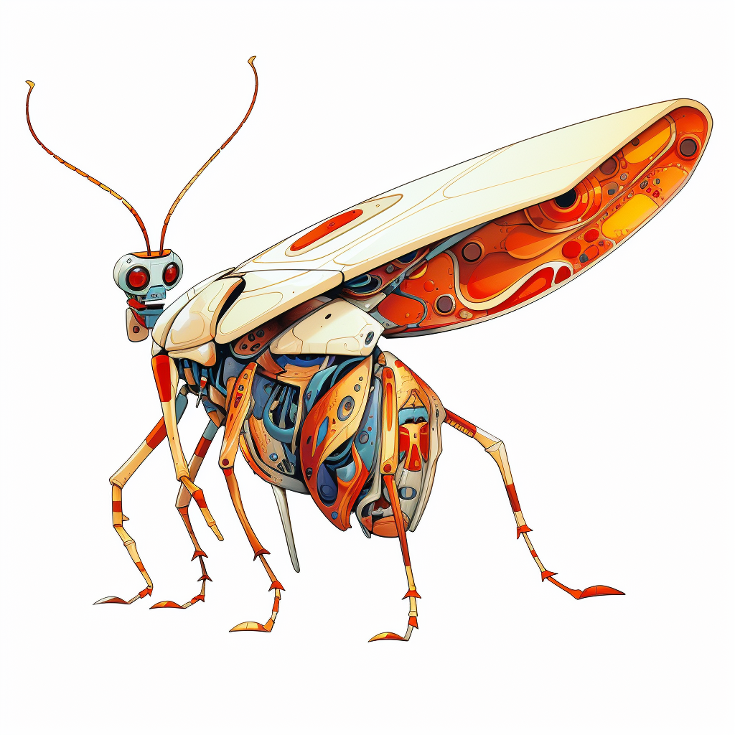
Debugging Fix problems
Lisa Schwetlick and Pamela Hathway
Notes:
If something goes wrong in your code and you get an error or a wring result, what do you do?
Does anyone just read their code, think about it, and find the error that way?
No?
So, How do you find the error? How do you find out how to fix it?
Probable answers
Debugger
Print statements
Jupyter: copy value into a new cell and execute cell
Who uses those strategies regularly?
The goal of this section is to motivate you to give debugging a try if you think you could improve the way to fix the problems in your code.

Slide 2

The agile development cycle
Pick your next feature
Write tests to check that feature works
pytest
Write simplest code that makes tests pass
Run tests and debug until all tests pass
pdb
timeit
cProfile
line_profiler
Refactor and optimize only if necessary
August 2023, CC BY-SA 4.0
Debugging, v2.0

Slide 3

What is Debugging?
The best way to debug is to avoid bugs
By writing tests, you anticipate the bugs
Your test cases should already exclude a big portion of the possible causes
Core idea in debugging: you can stop the execution of your application at any point, look at the state of the variables, and execute the code step by step
August 2023, CC BY-SA 4.0
Debugging, v2.0
Notes:
Bugs are inevitable

Slide 4

pdb, the Python debugger
Command-line based debugger
pdb opens an interactive shell, in which one can interact with the code
examine and change value of variables
execute code line by line
set up breakpoints
examine calls stack
August 2023, CC BY-SA 4.0
Debugging, v2.0

Slide 5

Entering the debugger
Enter debugger at the start of a file: python –m pdb myscript.py
Enter at a specific point in the code (easy alternative to print):
# some code here # the debugger starts here breakpoint() # rest of the code
August 2023, CC BY-SA 4.0
Debugging, v2.0

Slide 6

Demonstration!
Debugging with pdb
August 2023, CC BY-SA 4.0
Debugging, v2.0

Slide 7
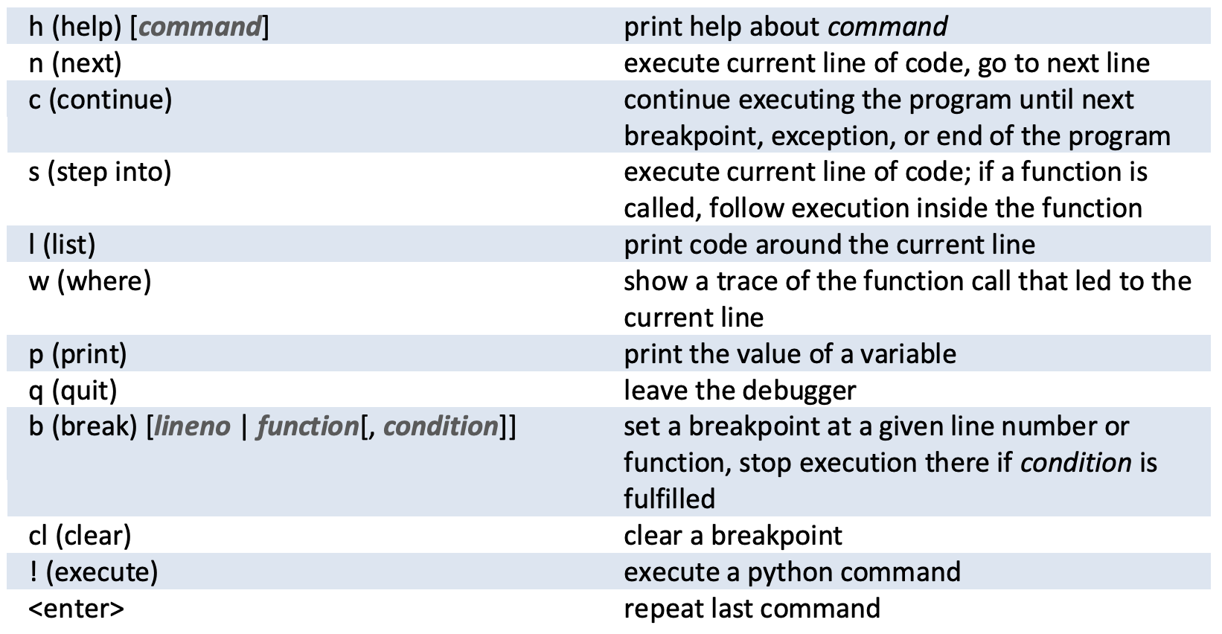

Hands-on!
1) Go to local_maxima_part3_debug/local_maxima.py and execute it
2) Go to local_maxima_part3_debug/test_local_maxima.py and execute all the tests there using pytest
3) Fix the tests one by one (you will have a few min at the end for a PR)
pdb cheatsheet:
August 2023, CC BY-SA 4.0
Debugging, v2.0

Slide 8
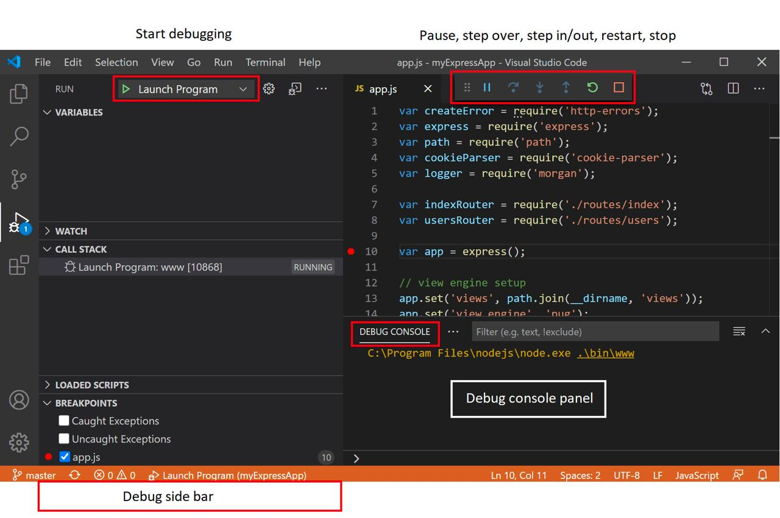

Entering the debugger from VSCode
August 2023, CC BY-SA 4.0
Debugging, v2.0

Slide 9
Demonstration!
Debugging with pdb
Debugging from an IDE
August 2023, CC BY-SA 4.0
Debugging, v2.0

Slide 10
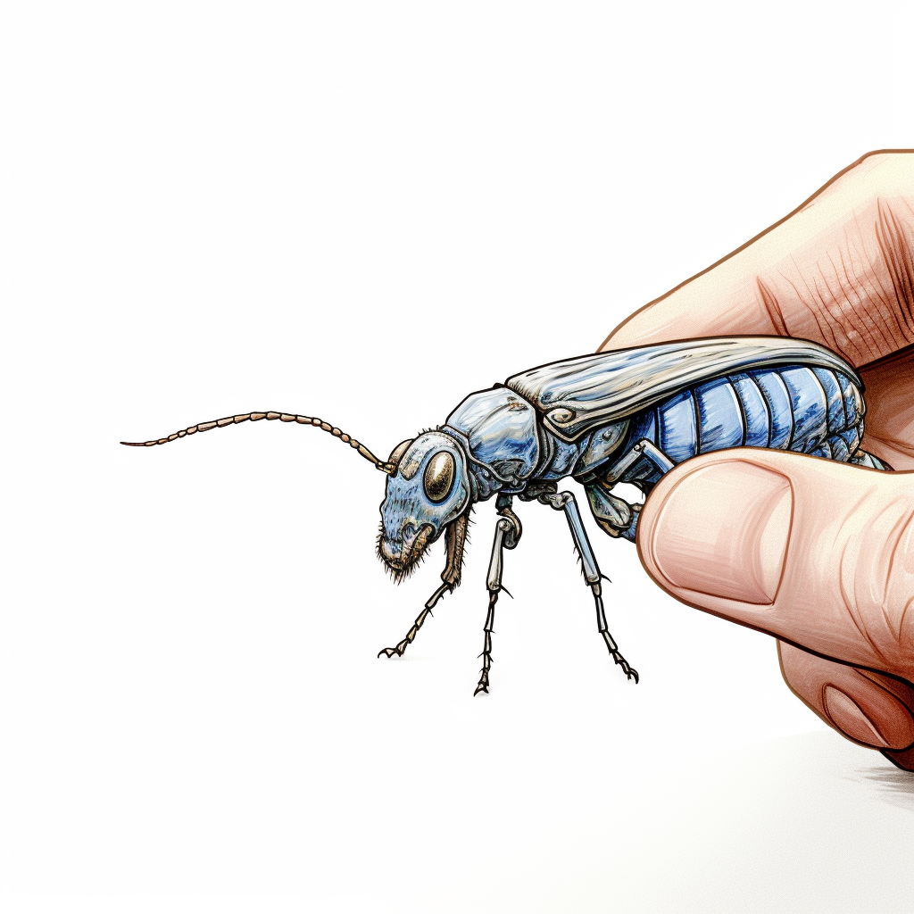
How to react to a bug
Add a test that matches the behavior you expect. It will fail and reproduce the bug
Debug and fix the the bug
Run the tests until they all pass (go back to 2 if necessary)
Now your bug is fixed *and* it will never occur again!
August 2023, CC BY-SA 4.0
Debugging, v2.0

Slide 11
Up next: Continuous Integration
August 2023, CC BY-SA 4.0
Testing scientific code, v16.0

Slide 12
August 2023, CC BY-SA 4.0
Debugging, v2.0

Slide 13

Entering the debugger from Jupyter
%pdb – preventive
%debug – post-mortem
August 2023, CC BY-SA 4.0
Debugging, v2.0

Slide 14
Hands-on!
Change this exercise!!!!
Maybe debug a script or maybe even better - a test?
Go to bug_hunt/file_datastore.py and execute it
It fails! But… it works when the base_path is an absolute path :-(
data = b'A test! 012' datastore = FileDatastore(base_path='./datastore') datastore.write('a/mydata.bin', data) # This should pass! assert os.path.exists('./datastore/a/mydata.bin’)
August 2023, CC BY-SA 4.0
Debugging, v2.0
Notes:
Live coding, right?
Exercise/example:
multiple function calls within each other to see stack calls
Multiple variables where values are unclear / can be None
Unexpected behaviour of a function (maybe an if not that then returns None, …)
Multiple bugs that grow in severity with one test each and if they fixed one, they go on to fix the next
Maybe my own find_maxima function with some more complicated stuff in there?
main function with function calls to finding maxima (option to choose what to do with saddle points, and then not having defined that properly or given this variable to the lower function), plotting maxima
Level 1: Easy fix to add an if [] return []
Level 2:
Level 3: something about saving the figure in an absolute path or not?
Remember that they are using the pdf debugger for this. Show running of pytest, then finding the line that errors out, adding a breakpoint to there and then running pytest again.
Suggest to have the terminal and the module side by side!
Show
evaluation of variables
Plotting options

Slide 15

Static checking and linting
Modify this and adapt to not have overlap with organising lecture
One of the problems with debugging in Python is that most bugs only appear when the code executes.
“Static checking” tools analyze the code without executing it.
pep8: check that the style of the files is compatible with PEP8
pyflakes: look for errors like defined but unused variables, undefined names, etc.
flake8: pep8 and pyflakes in a single, handy command
and also: yapf, black, …
August 2023, CC BY-SA 4.0
Debugging, v2.0
Notes:
Run flake8 on the *initial* pyanno code.

Slide 16
Hands-on!
Fix the bug in file_datastore.py, using the debugger
Submit a PR for issue #1 in the repository
pdb cheatsheet
August 2023, CC BY-SA 4.0
Debugging, v2.0

Slide 17
Tools for Debugging
Text editor + terminal → pdb (Python’s built-in debugger)
VSCode (IDE) → VSCode built-in debugger
PyCharm (IDE) → PyCharm built-in debugger
Jupyter → (?) built-in debugger
August 2023, CC BY-SA 4.0
Debugging, v2.0
Notes:
Did not cover jupyter debugging, because if you are doing such complicated things in jupyter that require debugging, you would probably be better off using an IDE ☺. Also, the concept is the same, you will figure it out if you need to
Did not cover jupyter in general, because pytest does not cover tests in jupyter notebooks, it is designed to work with .py files.
Notes from previous slides:
Note that the agile development cycle works best when you are using modules, so .py files and pytest and not Jupyter notebooks.
Notebooks cannot run tests properly.
There maybe is a way to run pytest within one Jupyter notebook, but you lose the possibility of running all of your tests automatically across all files, which really is what you want.
I will not cover debugging in jupyter because it is defeating the point. Jupyter imo is a replacement for debugging, but is not necessary.

Slide 18

Hands-on!
Run flake8 on one the files you edited today
August 2023, CC BY-SA 4.0
Debugging, v2.0

